Slide 1
How to link to a website in PowerPoint
Bryan Mills

Slide 2
Simplest
Simply by copying and pasting a web address you get a link:
http://yolandephilpott.weebly.com/

Slide 3
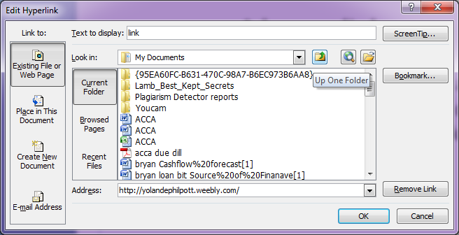
A text hyperlink
Copy the web address, write some text and then select it with the mouse and right click and select Hyperlink and paste your link:
An example of a link

Slide 4
A picture hyperlink
Copy the web address, insert a picture and then select it with the mouse and right click and select Hyperlink and paste your link:

Slide 5
Embeded
First download PowerPoint LiveWeb
You will now see these:
And follow instructions ☺ (results on next slide)

Slide 7
And that’s it ☺

